Slide 1
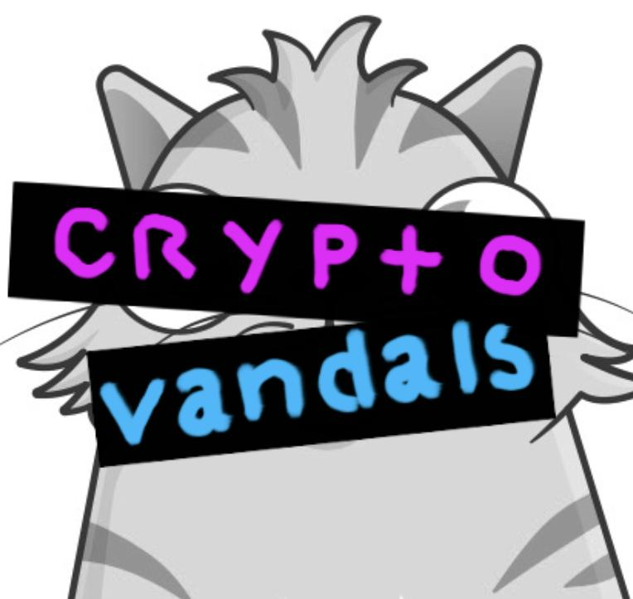
.
Liberate your NFTs
cryptovandals.com
Notes:
We are Greg and Alberto.
We’ve been working together on art-on-blockchain since 2015.
Our project is called CryptoVandals.
www.cryptovandals.com https://twitter.com/cryptovandals
Current version of this presentation is here:
https://docs.google.com/presentation/d/1chZMI_m_qRZDYNlmE3ic9zPSA3U_md0vNbWYdlkBBJg/edit?usp=sharing

Slide 2
Why CryptoVandals?
Notes:
We are excited about the potential for NFTs.
We’re both oldschool internet people. We grew up on the weird wild web, before surveillance capitalism locked it down.
We’re excited about the potential of NFTs to break down those walled gardens and let creators be fairly compensated.

Slide 3
NFT platforms are building walled gardens.
NFTs deserve better.
Notes:
But NFT platforms are building new walled gardens that break the promises of NFTs.
Read our manifesto! https://github.com/cryptovandals/contracts/blob/main/MANIFESTO.md

Slide 4
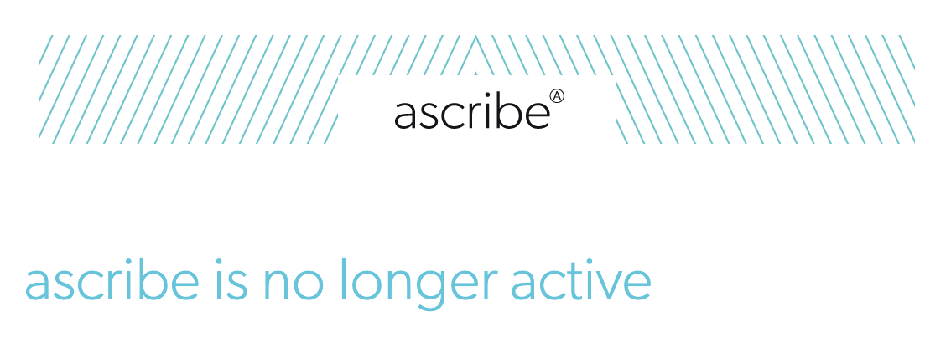
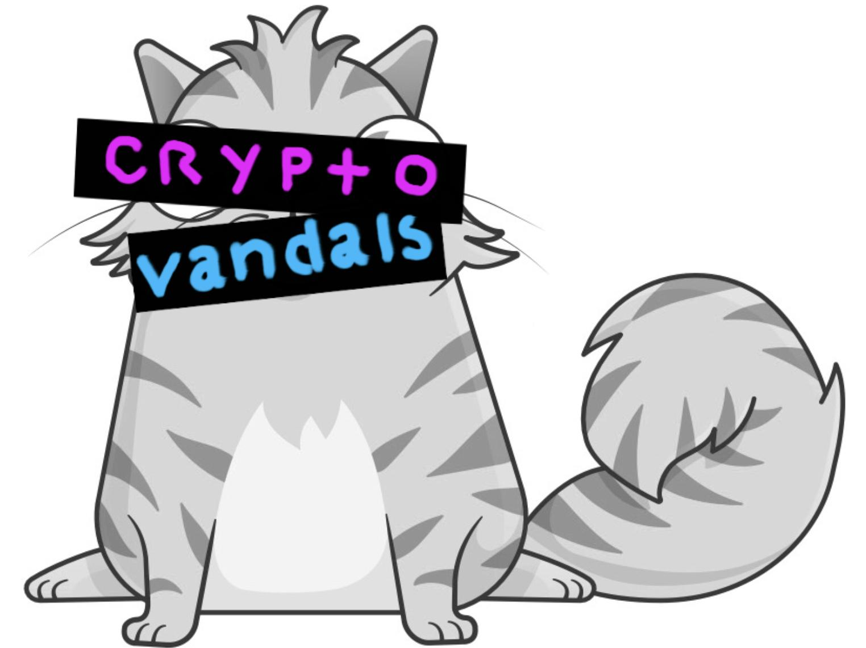
Centralized
content hosting
Notes:
First problem—centralized hosting. If the server goes down, the content is lost.
We both worked at ascribe.io, which was the very first art on blockchain startup. The transaction records are still on the bitcoin blockchain, but when the company pivoted they shut down ascribe and the art was lost.
That includes the first ever NFT sold to a museum, way back in April 2016, before NFT was a term. https://www.artnews.com/art-news/market/mak-vienna-becomes-first-museum-to-acquire-art-using-bitcoin-a-harm-van-den-dorpel-3995/

Slide 5
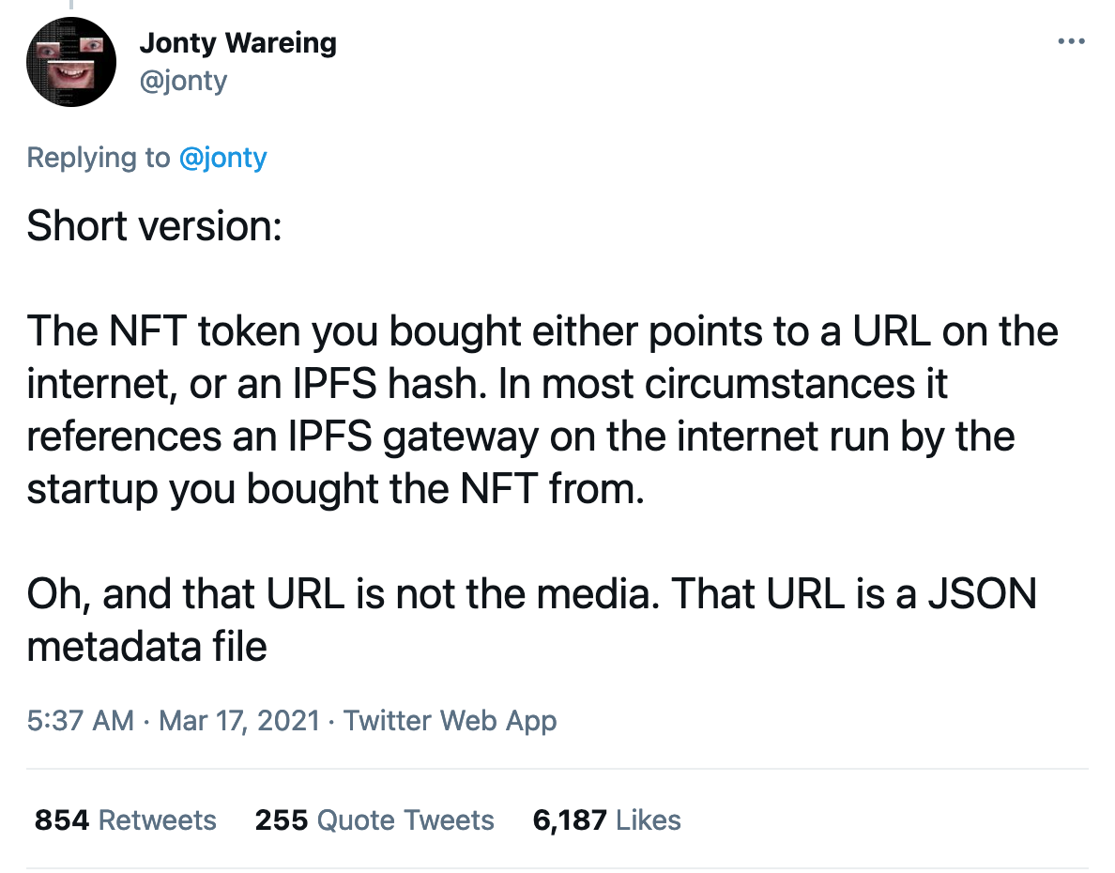
Proprietary gateways
Notes:
But even if the content is stored on IPFS, a proprietary gateway can break it.
Or be pointed to different content.
See: https://twitter.com/jonty/status/1372165292751732740
Most startups fail, so even startup marketplaces with good intentions risk stranding their users’ NFTs.
There is even a potential “hostage situation” where someone buys the domain and requires payment to keep hosting the content.
https://twitter.com/andrew___myname/status/1372182283965321221

Slide 6
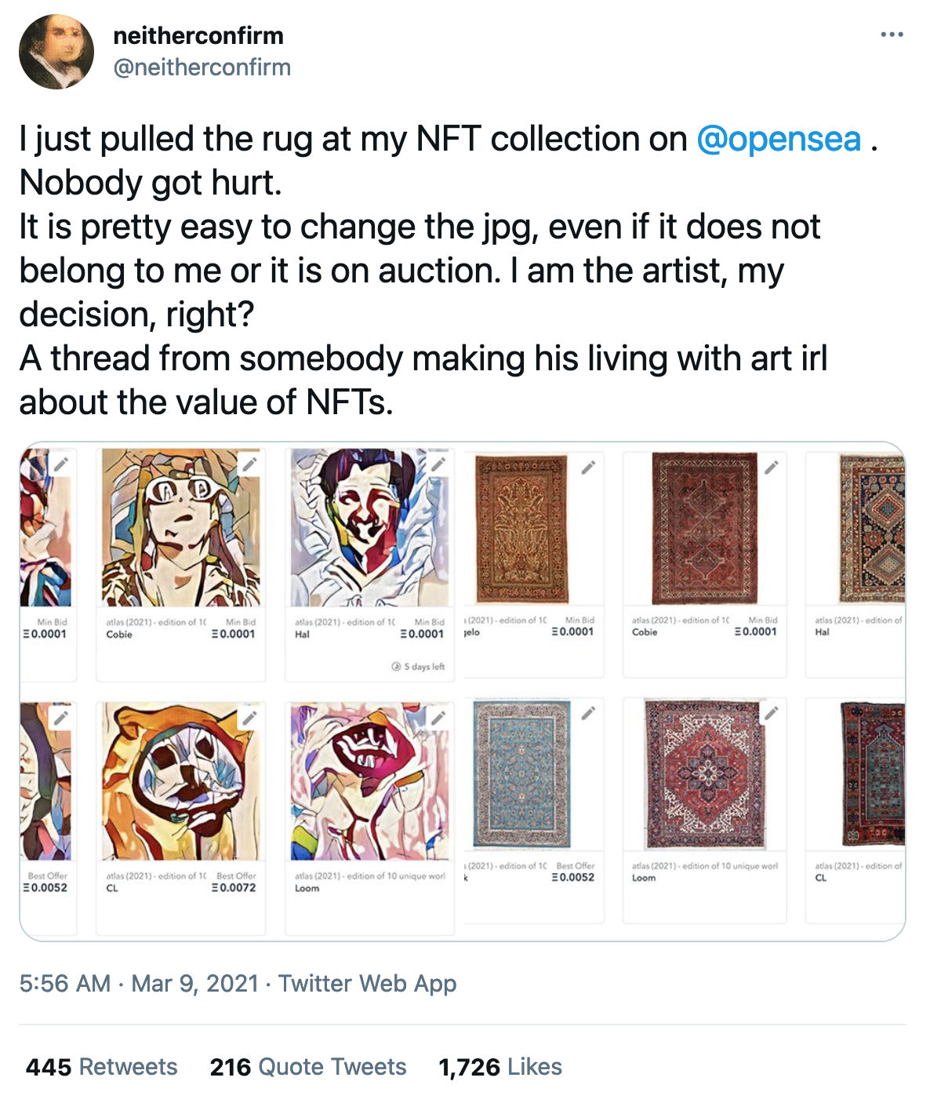
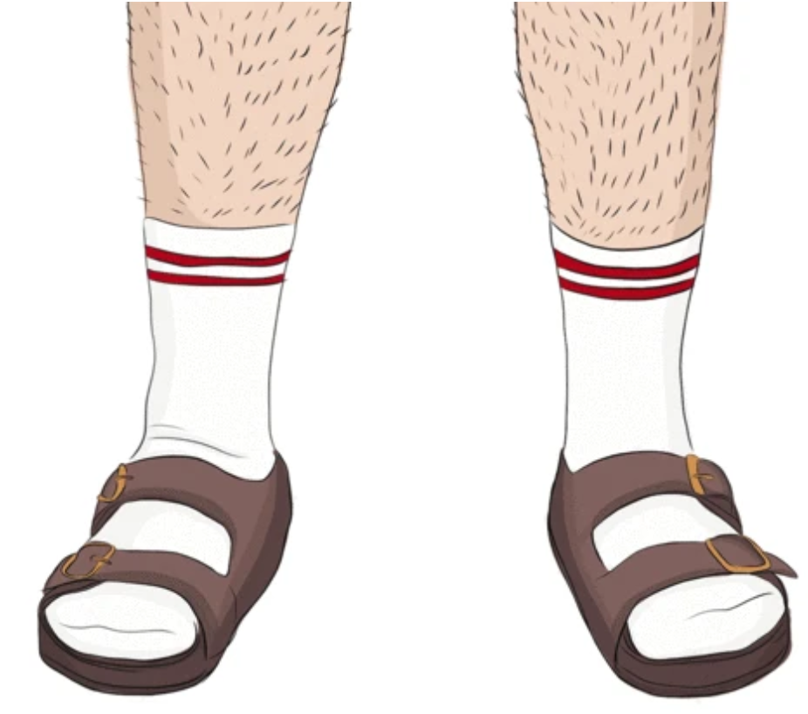
Rug pulls
crypto
sandals
Notes:
And if you can change the file or what the gateway points to, you can change the content.
This “rug pull” was demonstrated by @neitherconfirm, who replaced their NFT paintings on Opensea with pictures of actual rugs… which is more a rug push, but whatever.
See: https://twitter.com/neitherconfirm/status/1369285946198396928
Milkshop.ca lets you buy that socks and sandals image as a greeting card. Image is used under Canadian fair dealing copyright exemptions. https://milkshop.ca/products/socks-and-sandals-greeting-card

Slide 7
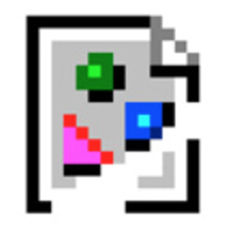
A single point of failure is
is going to fail eventually.
Notes:
The point is: a single point of failure is going to fail eventually.
A single point of failure is also a point of control, which lets the platforms call the shots.

Slide 8
What is CryptoVandals?

Slide 9
CryptoVandals is a tool to liberate or vandalize the NFTs you own.
Notes:
CryptoVandals is a tool to liberate or vandalize the NFTs you own.

Slide 10
What is CryptoVandals?
It’s three things:
A smart contract that can liberate or vandalize ERC-721 NFTs.
A web application for the smart contract.
A manifesto that guides our work.
Notes:
It’s
A smart contract https://github.com/cryptovandals
A web app https://www.cryptovandals.com
and
A manifesto https://github.com/cryptovandals/contracts/blob/main/MANIFESTO.md

Slide 11
What does it do?
Uploads the content to IPFS.
Burns the original NFT.
A single transaction mints a new NFT:
Liberated NFT: Proprietary links and gateways replaced by open, accessible, content addressed IPFS links.
Vandalized NFT: Original linked content replaced by linked content of your choice.
Notes:
You can use CryptoVandals on any NFT you own.
Linked content is uploaded to IPFS.
Then in one transaction...
The original NFT is burned.
A liberated NFT is minted with content addressed IPFS links.
Or a vandalized NFT is minted with new content of your choice.

Slide 12
Demo
CryptoVandals in action
Notes:
Now Alberto will do a demo
https://cryptovandals.com
Requires Metamask
Change to Kovan network

Slide 13
What next?

Slide 14
Next steps for CryptoVandals
Integrate with The Graph to display all NFTs
Full-featured web application with improved UI/UX
Upload all content linked in JSON file, and update JSON file
Delegate vandalization - let someone else vandalize your NFT
NFT remix - combine provenance of multiple NFTs into one
Version history - show the history of changes to a NFT
Add Zora support - Zora NFTs shouldn’t lose royalties when liberated
Add Arweave support
Payment for hosting through Filecoin or Arweave
Notes:
We have a lot of plans for CryptoVandals.
Integrate The Graph to display all NFTs instead of manually adding contracts
Build a full-featured web application with improved UI/UX, ideally fully decentralized.
Upload all linked files if NFT points to a JSON file, and update links in JSON file linked by liberated NFT - kind of like what Internet Archive does.
Delegate vandalization, so you can let someone else vandalize your NFT.
Enable NFT remixes, so you can combine multiple NFTs into a single NFT, preserving provenance for all of them.
Display the version history of an NFT to show changes over time.
Add Zora support, so the creators of Zora-enabled NFTs don’t lose their royalty stream when their NFT is liberated.
Add Arweave support.
Enable payments for long-term hosting through Filecoin or Arweave.
Upload any terms of service or contract for sale and include link in the liberated NFT

